Slide 1

Lesson 6-1
Non-Context-Free Languages
Theory of Computation
王轩
Wang Xuan

Slide 2
Outline
Pumping lemma for CFG
Applications of The Pumping Lemma

Slide 3
Pumping lemma for CFG
If A is a context-free language, then there is a number p (the pumping length) where, if s is any string in A of length at least p, then s may be divided into five pieces s=uvxyz satisfying the conditions
  For each i>=0, uv^{i}xy^{i}z∈A
  |vy|>0, and
  |vxy|<=p

Slide 4
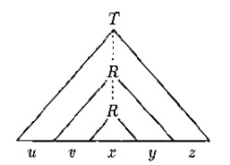
Idea
Let A be a CFL and let G be a CFG that generates it
Let s be a very long string in A, there will be a parse tree.
On this long path some variable symbol R must repeat because of the pigeonhole principle.

Slide 5

Proof
Let b be the maximum number of symbols on the right-hand side of a rule
Level 0:
nodes
Level 1:
b nodes
b nodes

Slide 6
Maximum number of nodes per level
Level 0:
nodes
Level 1:
b nodes
Level 2:
b² nodes
b nodes
b nodes
b² nodes

Slide 7

Maximum number of nodes per level
Level 0:
nodes
Level :
b^{i} nodes
Level h:
b^{h} nodes
If a string is at least b^{h}+1 long, each of its
Parse tree must be at least h+1 high

Slide 8
Proof
Set |V| is the number of variables in G.
We set pumping length p to be b^{|V|+1} >b^{|V|}+1, Thus if the length string s is p or more, its parse tree must be at least |V|+1 high.
Choose T is a parse tree that has the smallest number of nodes. Its longest path from root to leaf has length at least |V|+1. The path has at least |V|+2 nodes, at least |V|+1 variables.
G have only |V| variables, thus, some variable R appears more than once on that path.

Slide 9








Pigeons:
Pigeonholes :
(Variables in G)
(Variables in the path)
some variable
is repeated
Repeated
Variable
Variables in G
Derivation tree of

Slide 10
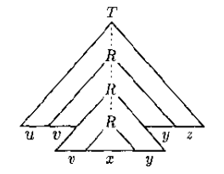
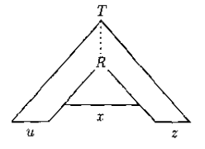
We divide s into uvxyz
The occurrence of R generates vxy (larger subtree), x (smaller subtree)
Thus, repeat R with vxy is still a valid tree, condition 1 is satisfied.
(condition 3)For each i>=0, uv^{i}xy^{i}z∈A

Slide 11
(condition 2) v and y are not both ε. Otherwise, it generate a parse tree have fewer nodes than T. |vy|>0
(condition 3) We choose R that both occurrence of R within bottom |V|+1 variables.
R generate vxy. So the subtree R generate vxy at most |V|+1 high. The length of string is less than b^{|V|+1} =p |vxy|<=p

Slide 12
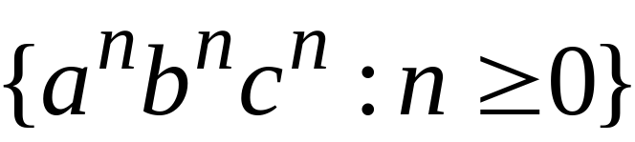

Applications of The Pumping Lemma
Non-context free languages
Context-free languages

Slide 13
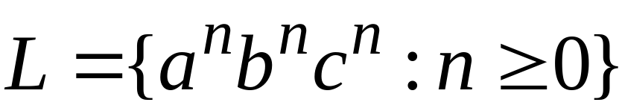
Theorem:
The language
is not context free
Proof:
Use the Pumping Lemma
for context-free languages

Slide 14

Assume for contradiction that is context-free
Since is context-free and infinite
we can apply the pumping lemma

Slide 15


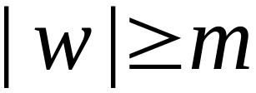
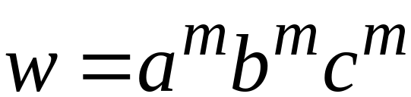
Let be the critical length
of the pumping lemma
Pick any string with length
We pick:

Slide 16

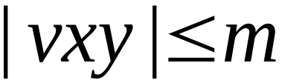
From pumping lemma:
we can write:
with lengths and
|vy|>0

Slide 17
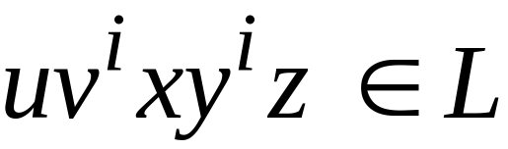

|vy|>0
Pumping Lemma says:
for all

Slide 18


|vy|>0
We examine all the possible locations
of string in

Slide 19
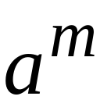

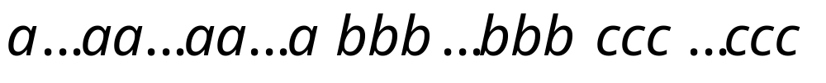


|vy|>0
Case 1:
is in

Slide 20
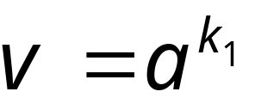
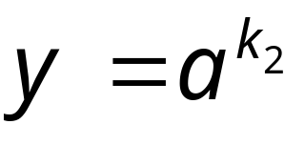
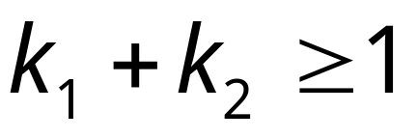




|vy|>0

Slide 21
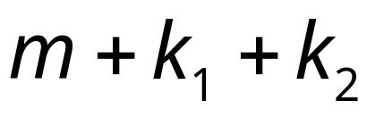
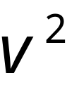
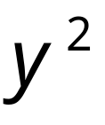
|vy|>0

Slide 22
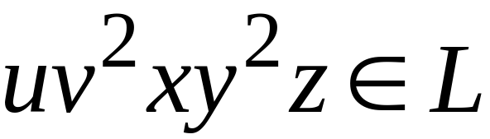
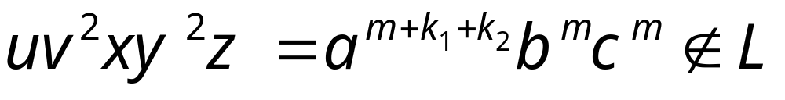
|vy|>0
From Pumping Lemma:
However:
Contradiction!!!

Slide 23
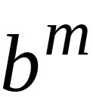
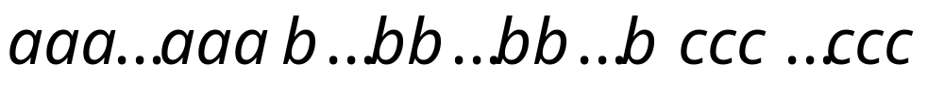
|vy|>0
Case 2:
is in
Similar to case 1

Slide 24
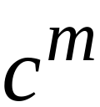
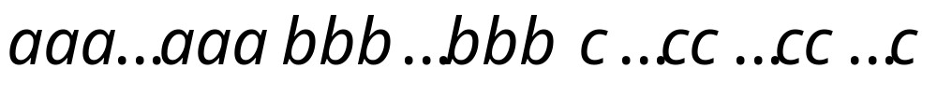
|vy|>0
Case 3:
is in
Similar to case 1

Slide 25
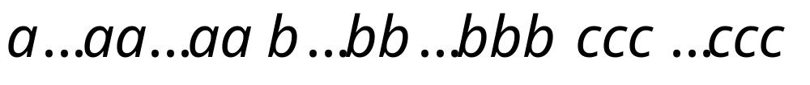
|vy|>0
Case 4:
overlaps and

Slide 26




|vy|>0
Sub-case 1:
contains only
contains only

Slide 27
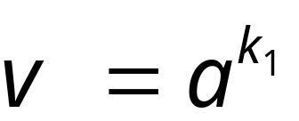
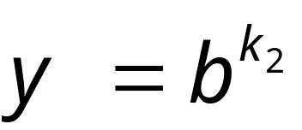
|vy|>0

Slide 28
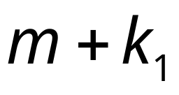
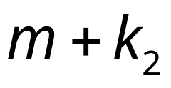
|vy|>0

Slide 29
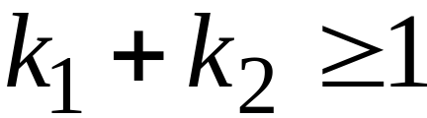
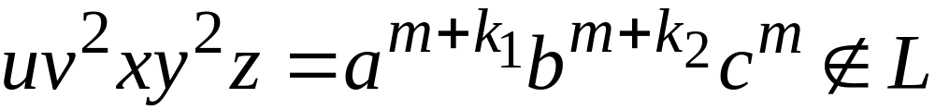
|vy|>0
From Pumping Lemma:
However:
Contradiction!!!

Slide 30
|vy|>0
Sub-case 2:
contains and
contains only

Slide 31
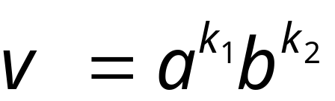

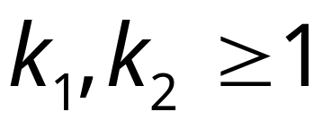



|vy|>0
By assumption

Slide 32
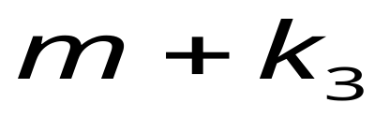
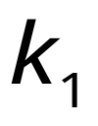
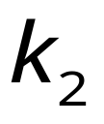
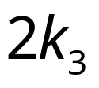
|vy|>0

Slide 33
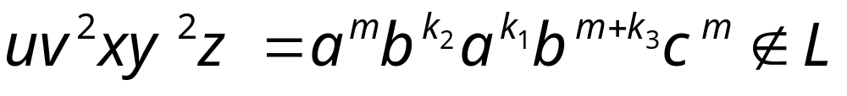
|vy|>0
From Pumping Lemma:
However:
Contradiction!!!

Slide 34
|vy|>0
Sub-case 3:
contains only
contains and
Similar to sub-case 2

Slide 35
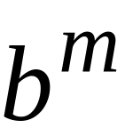
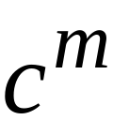
|vy|>0
Case 5:
overlaps and
Similar to case 4

Slide 36
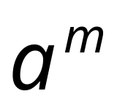
|vy|>0
Case 6:
overlaps , and
Impossible!

Slide 37
In all cases we obtained a contradiction
Therefore:
the original assumption that
is context-free must be wrong
Conclusion:
is not context-free

Slide 38
Review
Pumping lemma for CFG
Applications of The Pumping Lemma

